Slide 1

Bitcoin and
Blockchain

Slide 2





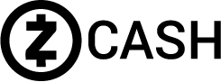


Who Am I?

Slide 3
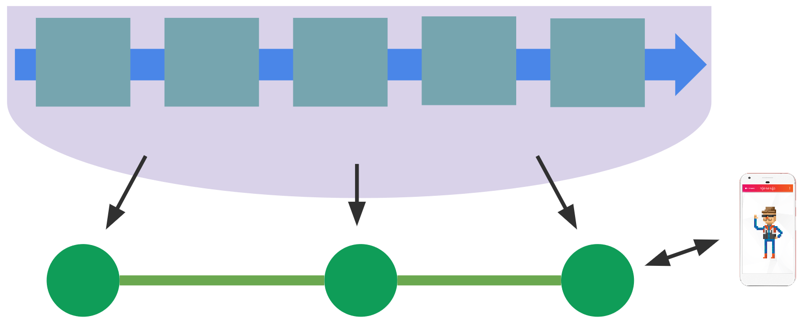
What is a blockchain?
A blockchain is a distributed, growing database
Each block contains data. These blocks form a chain.
The blockchain is stored on nodes, which share the copy.

Slide 4

Public vs. Private Blockchains
Bob downloads wallet software and connects to an open node
Alice runs node software on her home computer
Public: anyone can access it and host the infrastructure

Slide 5
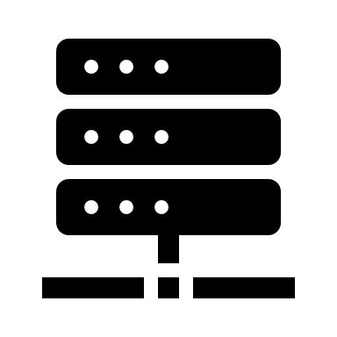
Public vs. Private Blockchains
Bob connects to company network on a company-issued phone
Alice is a sysadmin that maintains the blockchain on Amazon AWS
Private: only selected parties can access it and host
the infrastructure

Slide 6
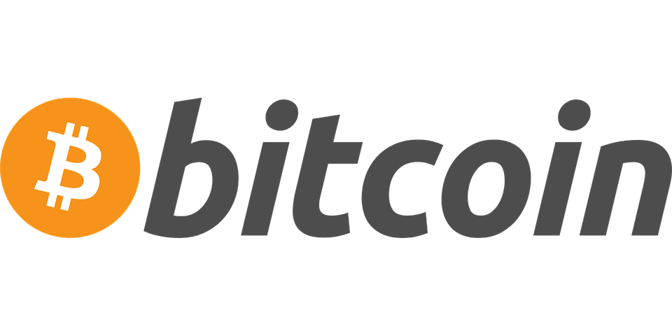
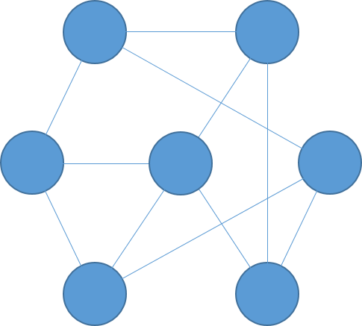
DECENTRALIZED
Older
Newer
BLOCK
Tx ID: wgis85cissajr5da7wz3fcnqnhift
Sender: w3fn5ujfm3d3r975qjd35jrwd4k5q
Receiver: nftic5k8sf4j598wf357jw38956659
Amount: 10 BTC
Notes:
In simple terms, Bitcoin is a decentralized network, where a history of the transactions is stored on thousands of computers around the world. This history is called the blockchain. The blockchain is a chain of blocks. Each block contains the most recent transaction history. There is a new block every 10 minutes. People will ask miners to include their transactions in the next block, often with a fee. The network automatically adjusts so that a new block can be added by one miner at random approximately every 10 minutes. Once a transaction is included in a block, it has a confirmation. People who are very cautious wait for several confirmations, since it is significantly harder to reverse an old transaction than a new one.

Slide 7
Bob
Alice
0.1 BTC
w3fn5ujfm3d3r975qjd35jrwd4k5q
nftic5k8sf4j598wf357jw38956659

Slide 8
Bob
Alice
0.1 BTC
w3fn5ujfm3d3r975qjd35jrwd4k5q
nftic5k8sf4j598wf357jw38956659

Slide 9


Slide 10

Mining (Proof of Work)
Tx ID: wgis85cissajr5da7wz3fcnqnhift
Tx ID: eh5vnc3c5bv ncxc3undm5x84q
Tx ID: cwab8nqf5ax7tcf45dxncnfmd3
Tx ID: t2C4hdsjz2xcn4renv5fadjxxje8e
Older
Newer
BLOCK

Slide 11
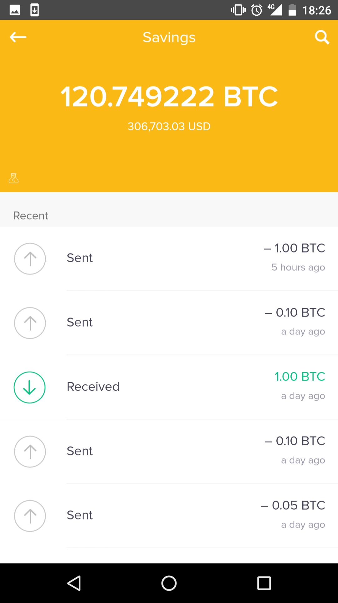
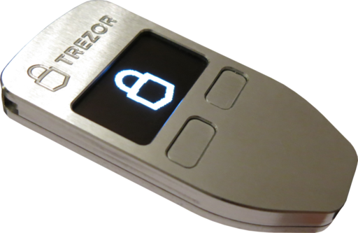
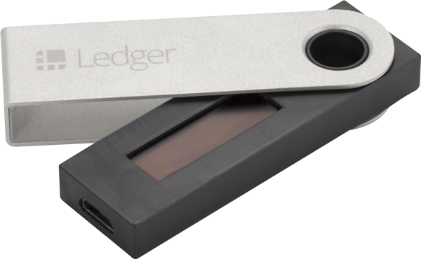
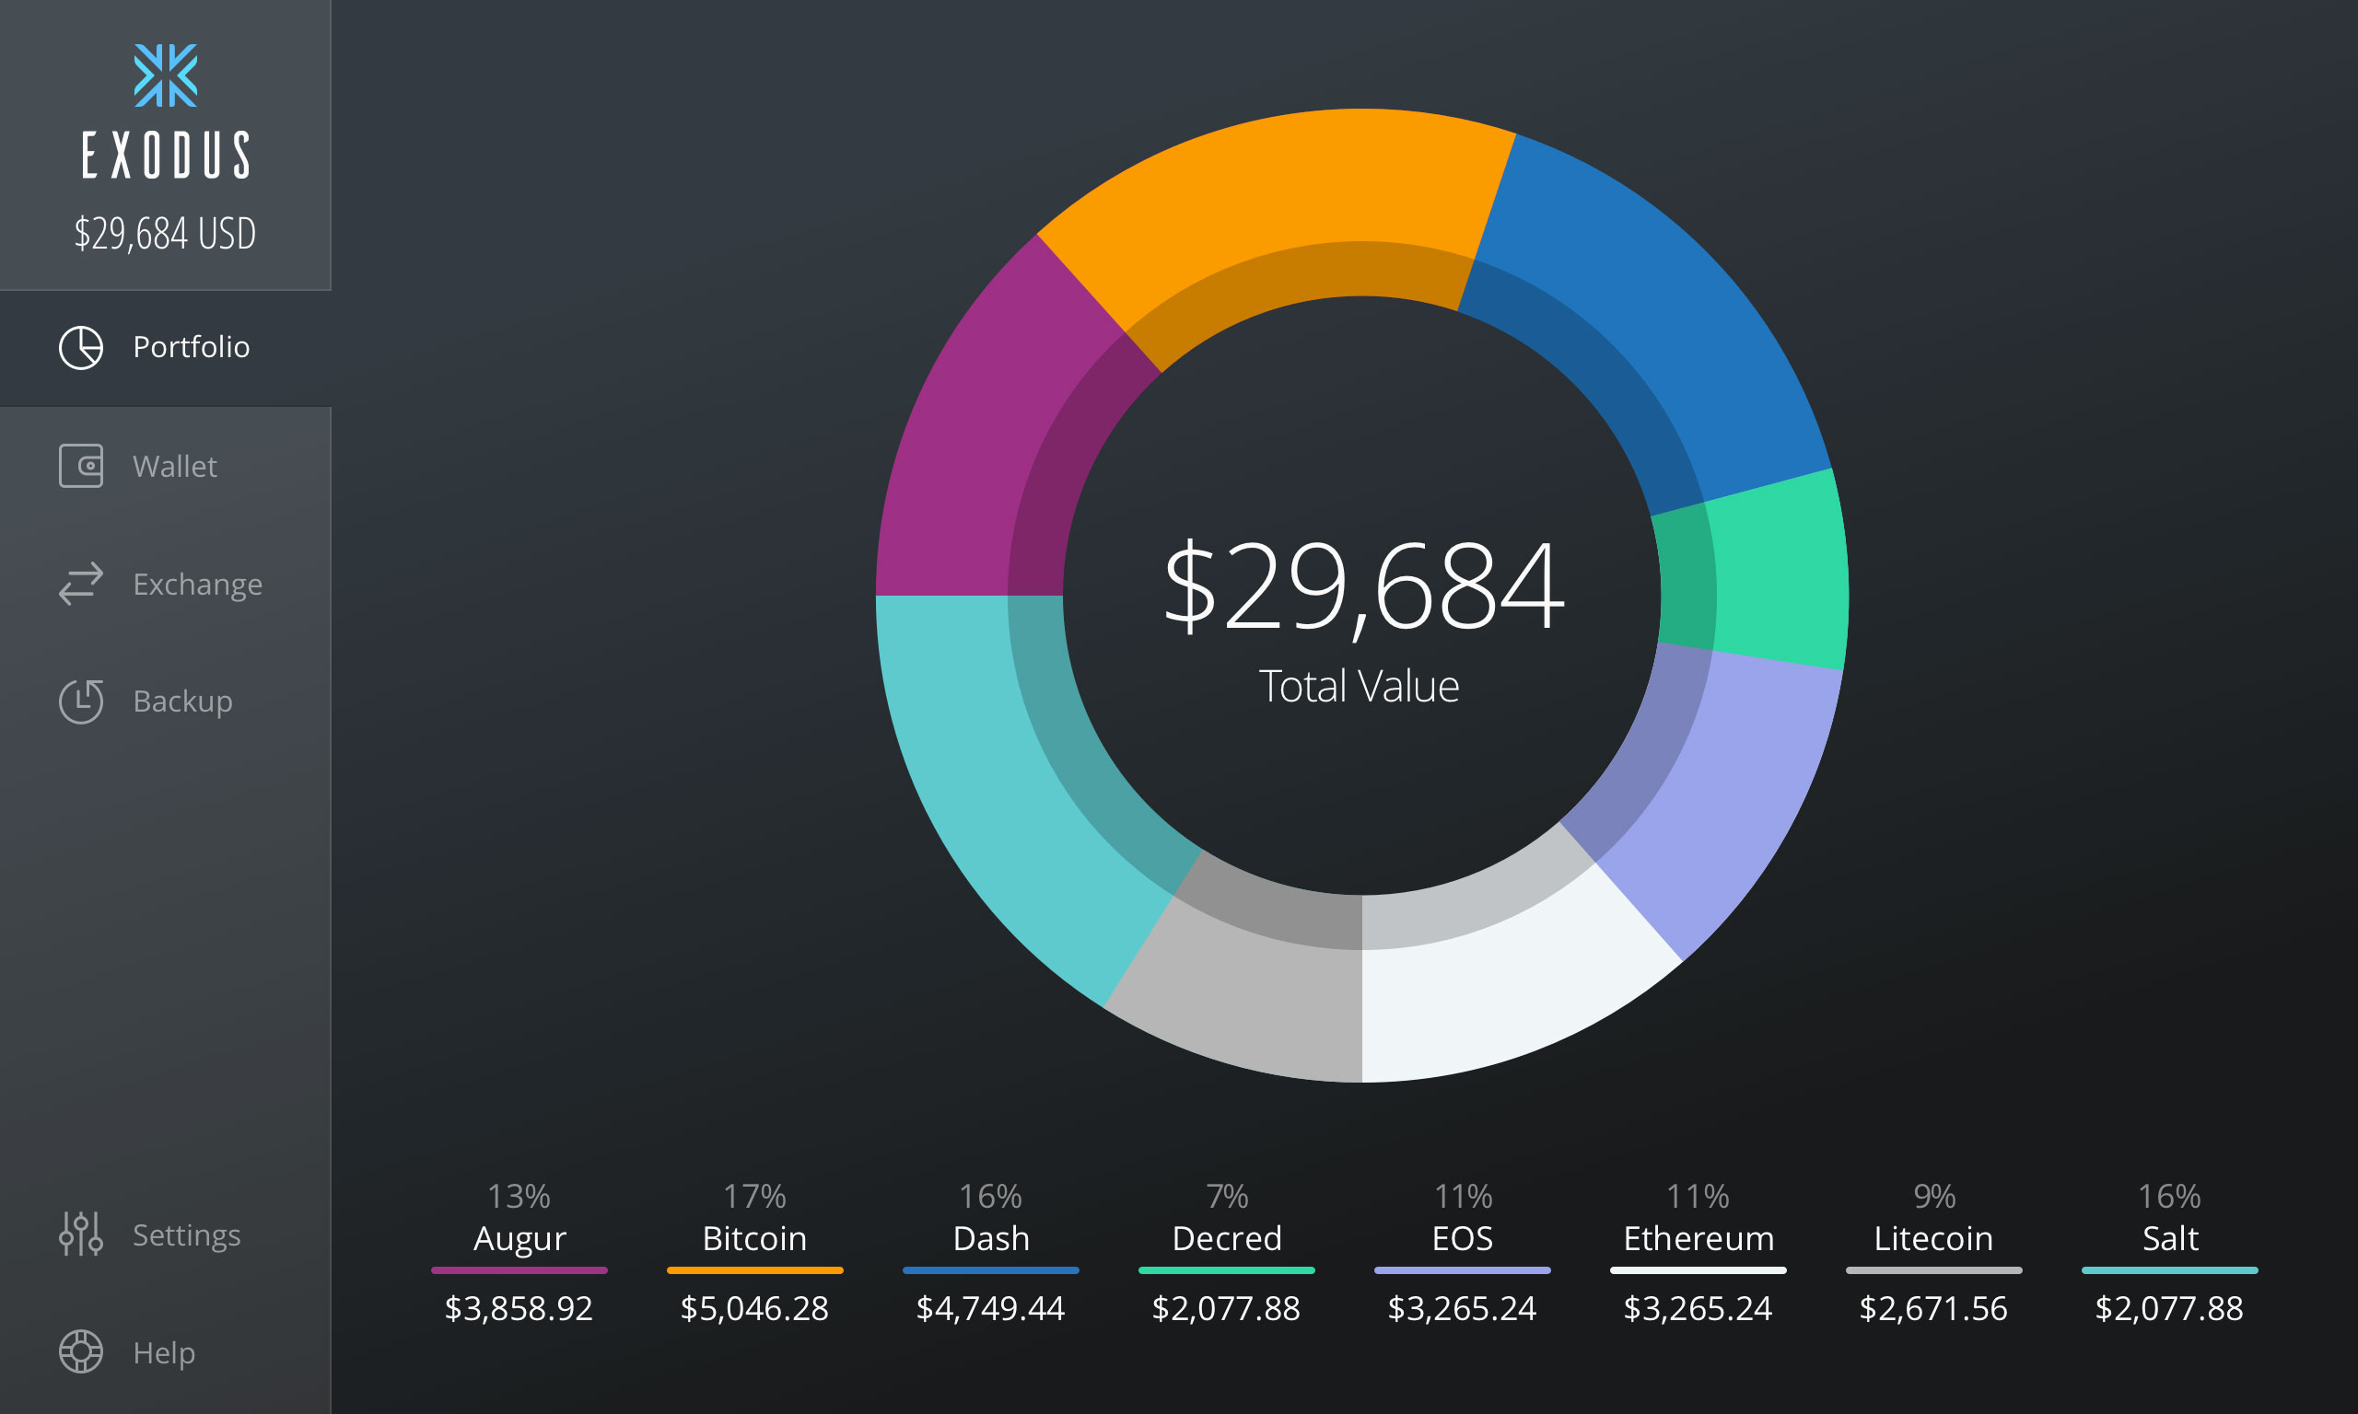
Wallets

Slide 12
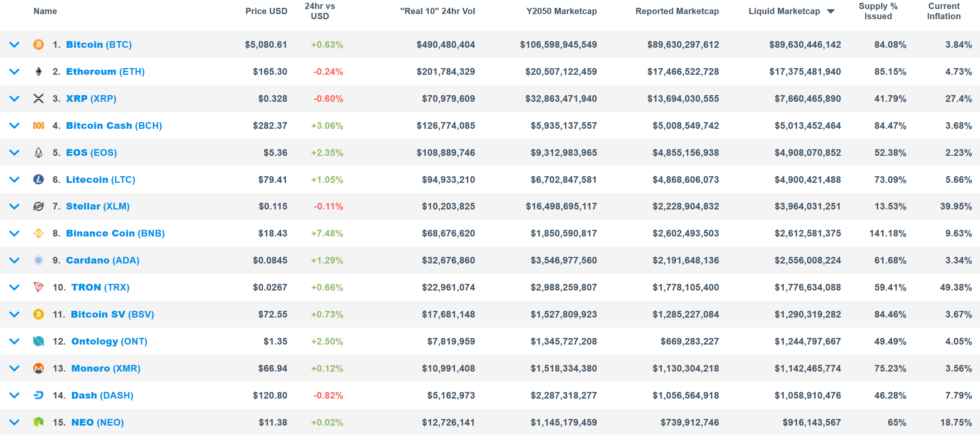
There are many options available

Slide 13
Discussion: Advantages and Disadvantages
What are some pros and cons to decentralized systems?
What are pros and cons of using a blockchain?

Slide 14
Advantages of Cryptocurrencies
Security. When implemented correctly, blockchains offer strong security.
Trust. When implemented properly, blockchains allow people to interact without any addition of trust in individual parties.
Privacy. Not all cryptocurrencies provide privacy, but decentralized, trustless technology opens the door for strong, trustless privacy. Centralized systems typically can only provide trusted privacy.
Open-source. Most cryptocurrencies are open-source, meaning that other people can review the code, improve it, or make their own projects. It’s accessible to all across borders.

Slide 15
Disadvantages of Cryptocurrencies
Inefficiency. Blockchain technology (and typically decentralized networks in general) are less efficient than centralized counterparts.
Scalability. No current cryptocurrency is proven to scale to hundreds/thousands of transactions per second.
Consensus conflicts. Decentralized networks need to agree, which is very difficult. If there are disagreements, different forks may occur.
Transparency. Most cryptocurrencies are completely transparent. This could cause unintended side-effect, such as missing fungibility.

Slide 16

Real problems, real solutions
I need an asset with predictable supply
I need an asset where funds are secure against attack
I need an asset where funds are kept private
I need access to a global economy
I need project code or contracts that are immutable
I need an auditable public record
I need to prove something without revealing why it’s true

Slide 17
Mini lesson: zero-knowledge proofs
A
B

Slide 18
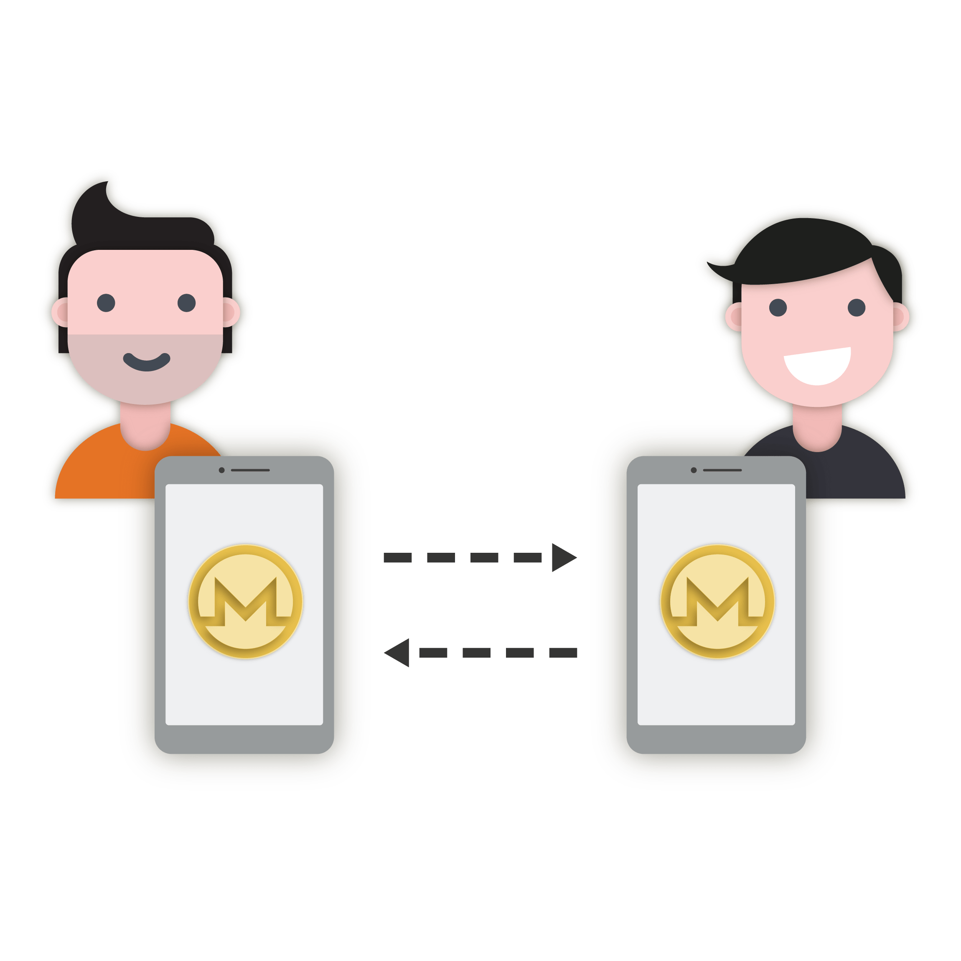
Quick Demo
Sending cryptocurrency transactions is similar to sending Venmo transactions, but people don’t really get it until they see it.
Myth: it takes 10 minutes to send a transaction. It takes time for it to be confirmed, but transactions will likely be included. You don’t need to wait that time for small transactions.

Slide 19
Institutional Adoption
Futures, forwards, and options
Clearer IRS guidelines
Clearer exchange compliance guidelines
More ICO regulation
Negative associations decreasing

Slide 20


Slide 21
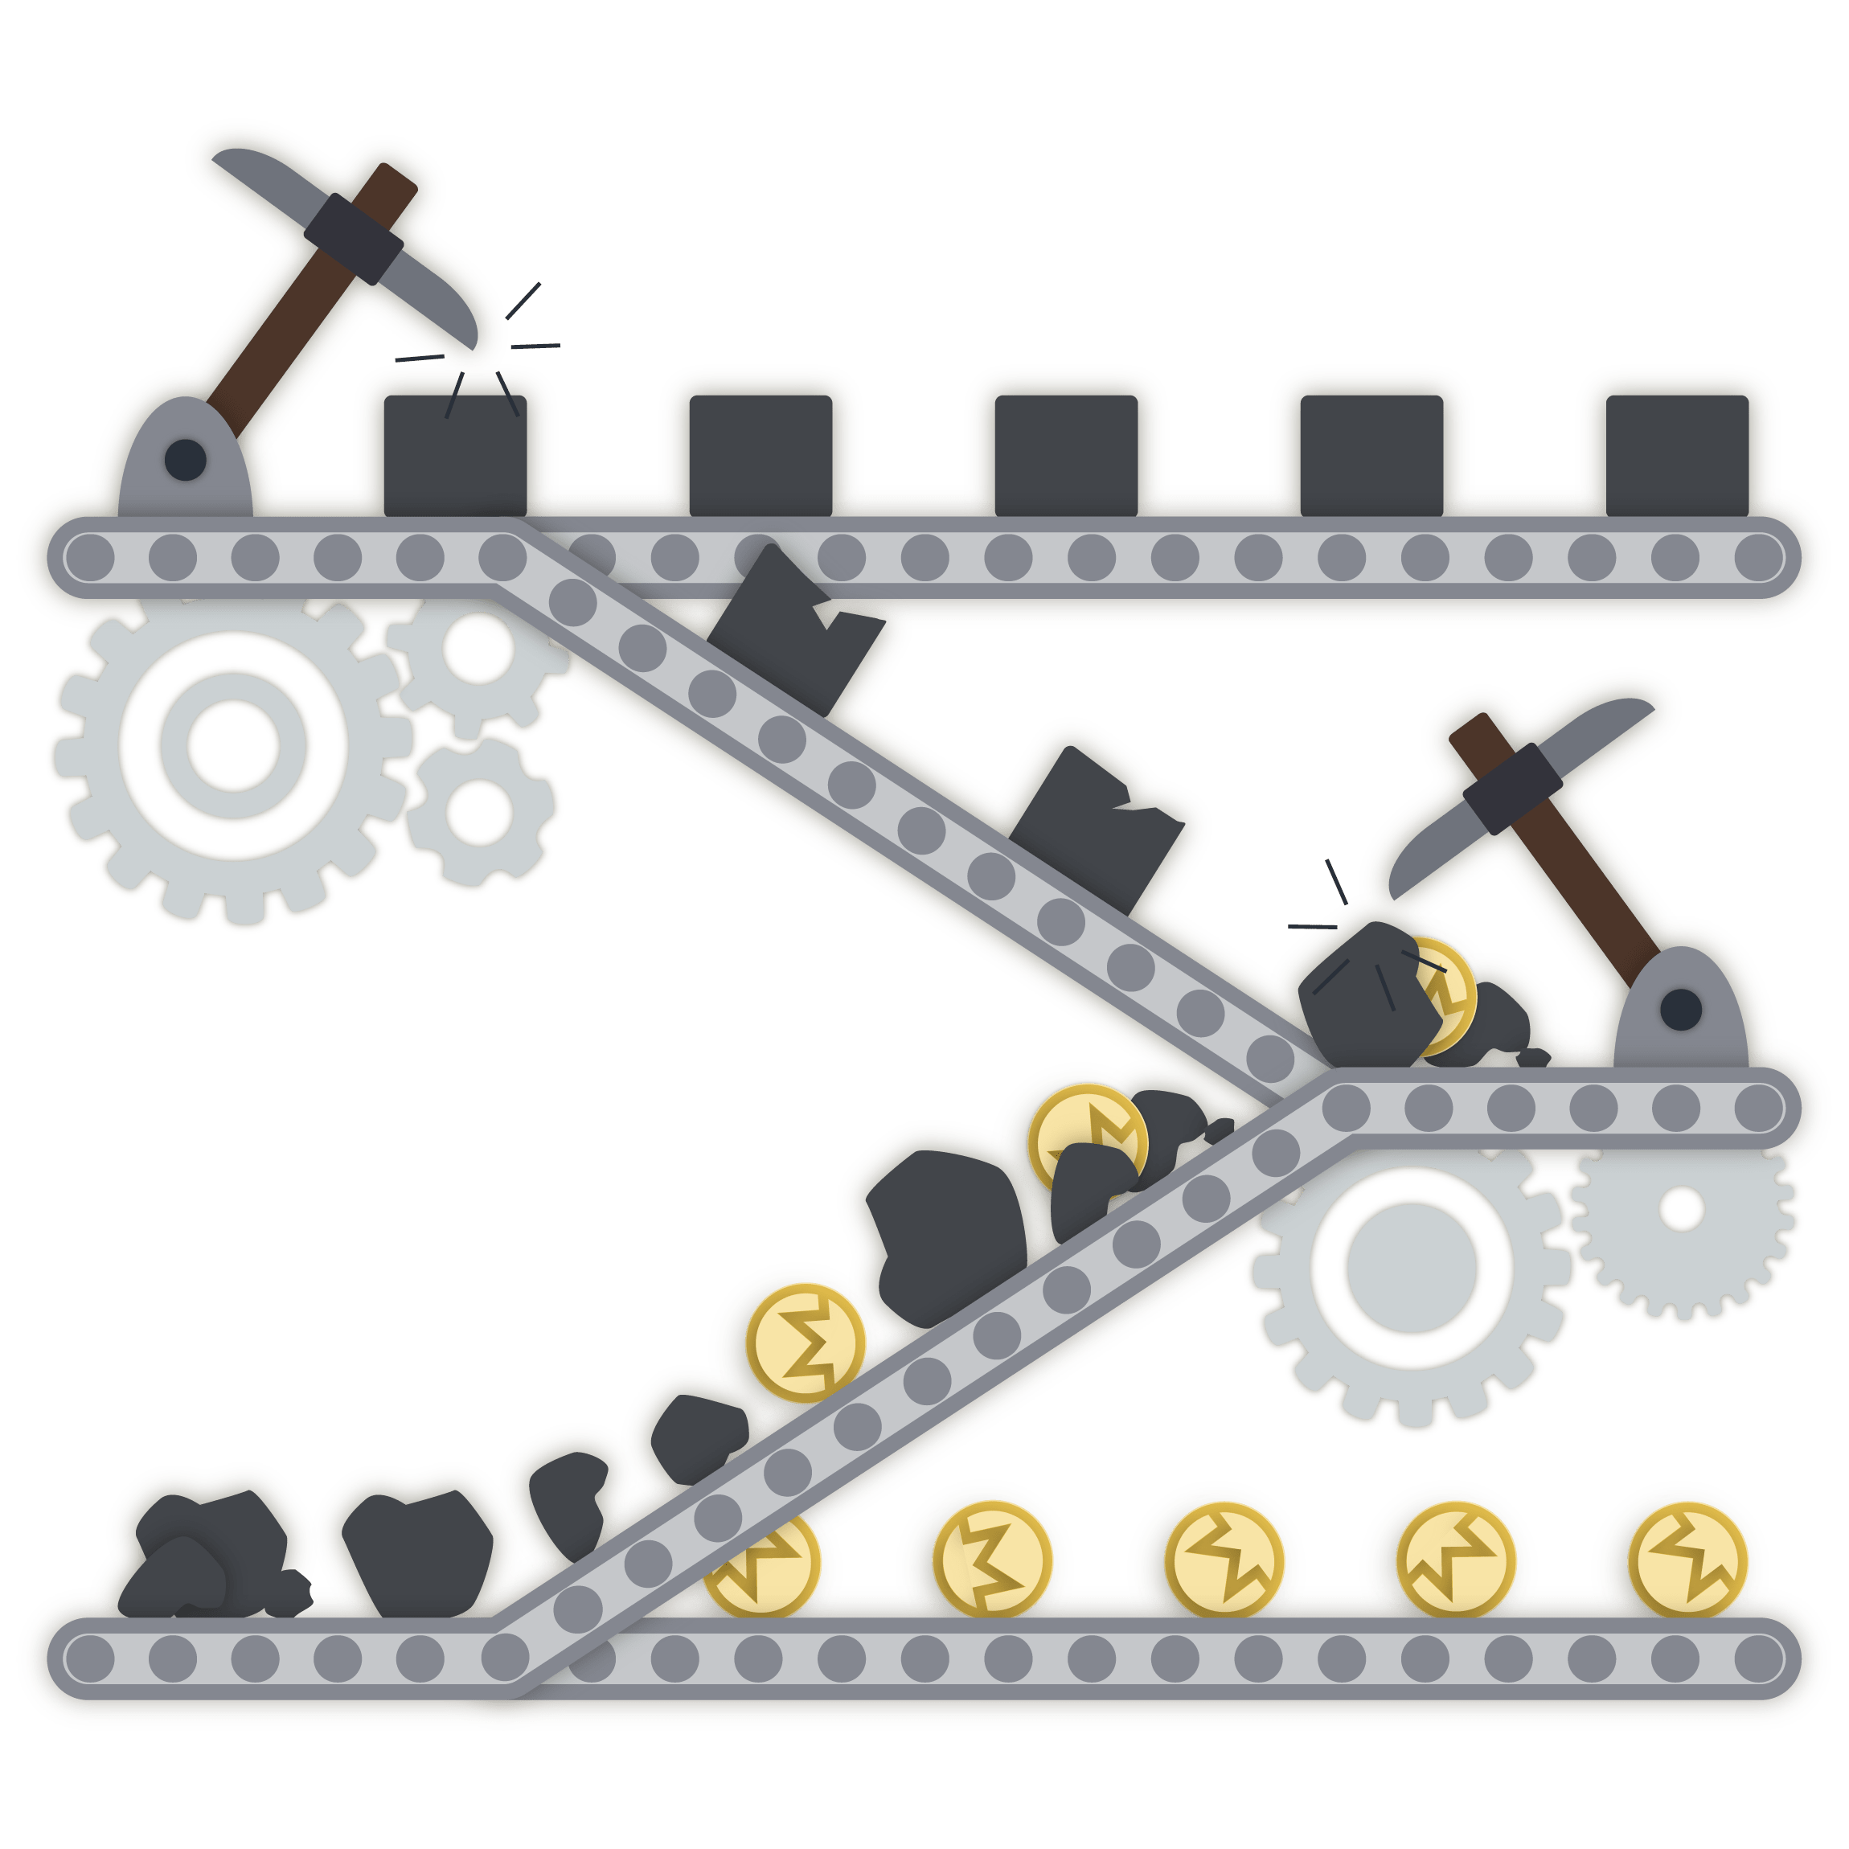
China and Hong Kong
Extremely difficult to assess accuracy of reports
Difficult to assess accuracy of project claims
High proportion of scams in the region
Chinese government imposes strict technology regulations
Chinese mining is a topic of debate

Slide 22
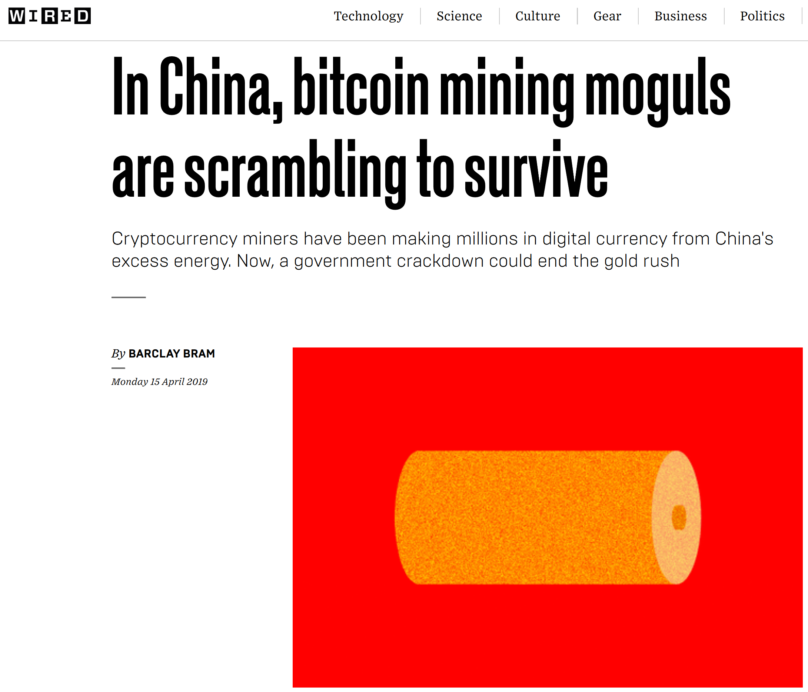
Key takeaways:
Mining is cheaper in China than most other parts of the world, since electricity is cheap and chip production occurs locally
China has banned purchases of cryptocurrencies on exchanges, leading to a strong OTC market
Mining is the main way to invest in cryptocurrencies in China, since there are few other options to earn it
China has strict controls on the ability to transfer money abroad, and cryptocurrencies challenge these regulations
China has strict controls on the internet

Slide 23

Key takeaways:
Hong Kong has no capital controls, so cryptocurrencies are less used compared to companies with strict capital controls
In-person trades are not popular
Cryptocurrencies were seen used as a pretext for ponzi schemes and as payment for criminal activity
“Although there is inherent ML/TF vulnerability related to VCs, there does not seem to be any visible impact affecting the overall risk in Hong Kong so far. The risk of VCs is assessed as medium-low”

Slide 24
What to do
Remain skeptical
Watch for efficiency and privacy improvements
Ask “why not use a centralized database?”
Demand more clarity from representatives
Come to club meetings if interested
Mine in dorm with free power :)

Slide 25



Thank You!
MAGICgrants.org
mncryptocurrency.org
@JEhrenhofer
ehren044@umn.edu
5137 9F1B A7FC 2D05

